Slide 1
Java Server Pages(JSP)
Unit 05

Slide 2
Overview of JSP technology
Java Server Pages (JSP) technology enables you to mix regular, static HTML with dynamically generated content. You simply write the regular HTML in the normal manner, using familiar Web-page-building tools. You then enclose the code for the dynamic parts in special tags, most of which start with <% and end with %>.
Even though servlets and JSP pages are equivalent behind the scenes, they are not equally useful in all situations. Separating the static HTML from the dynamic content provides a number of benefits over servlets alone, and the approach used in Java Server Pages offers several advantages over competing technologies.

Slide 3
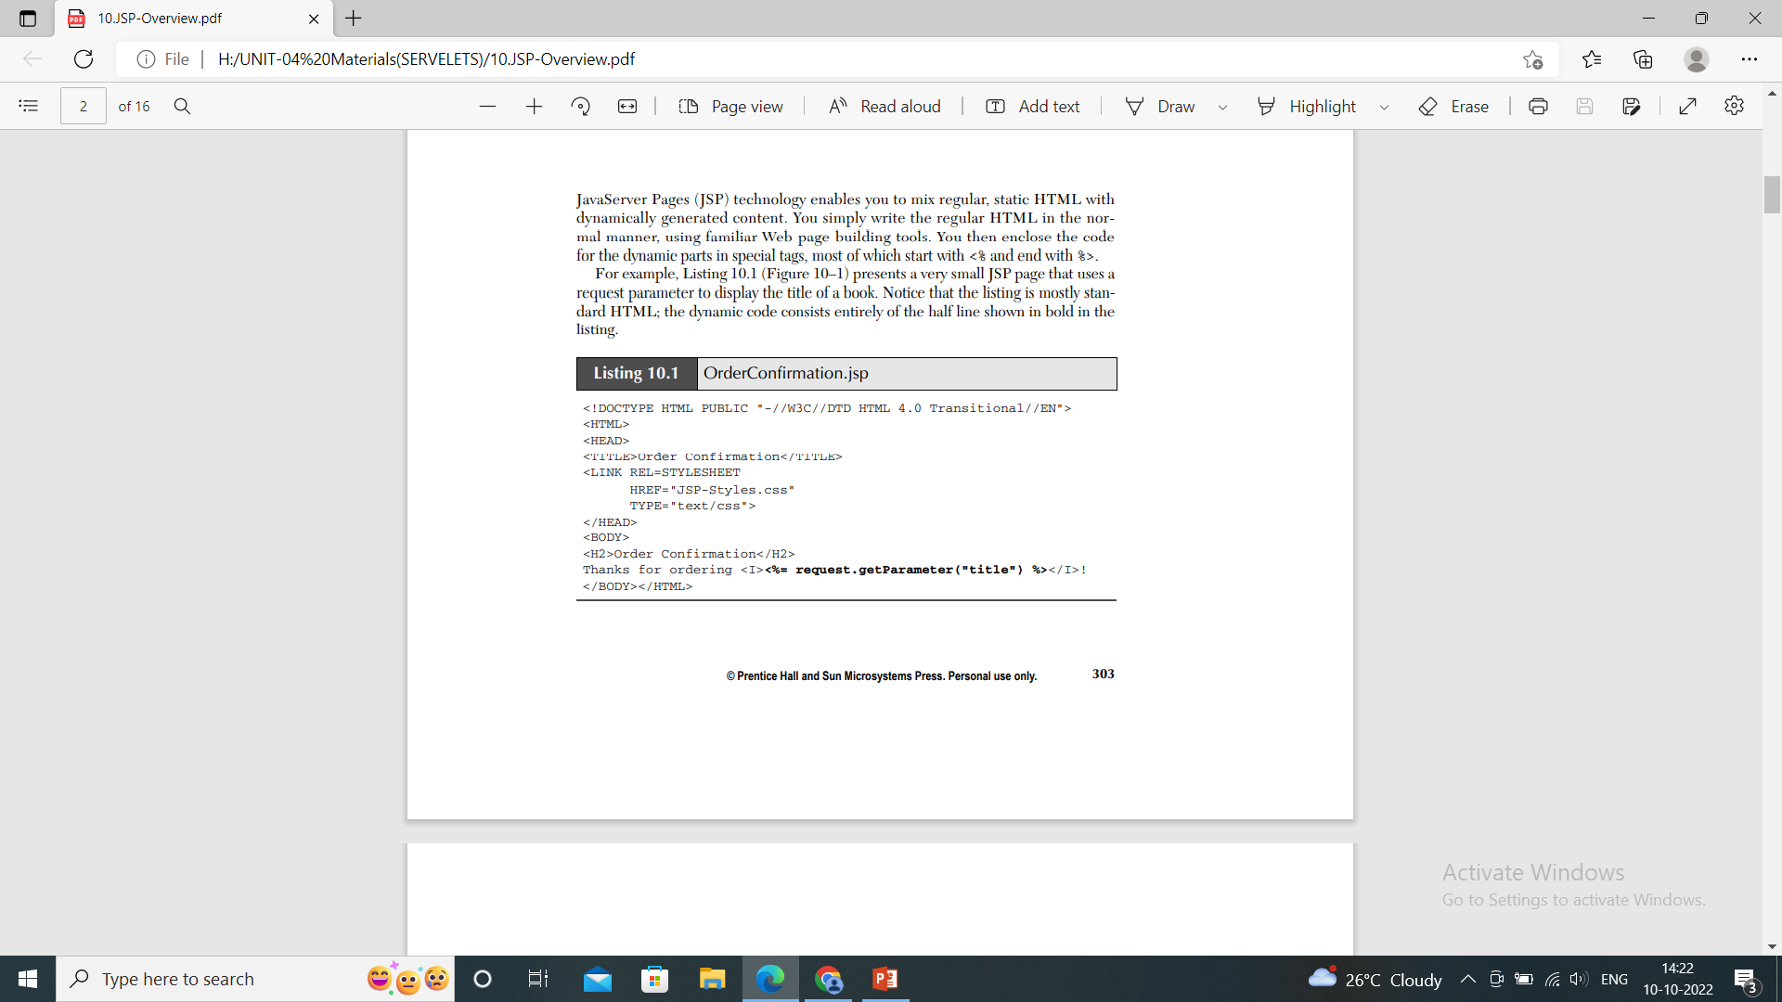
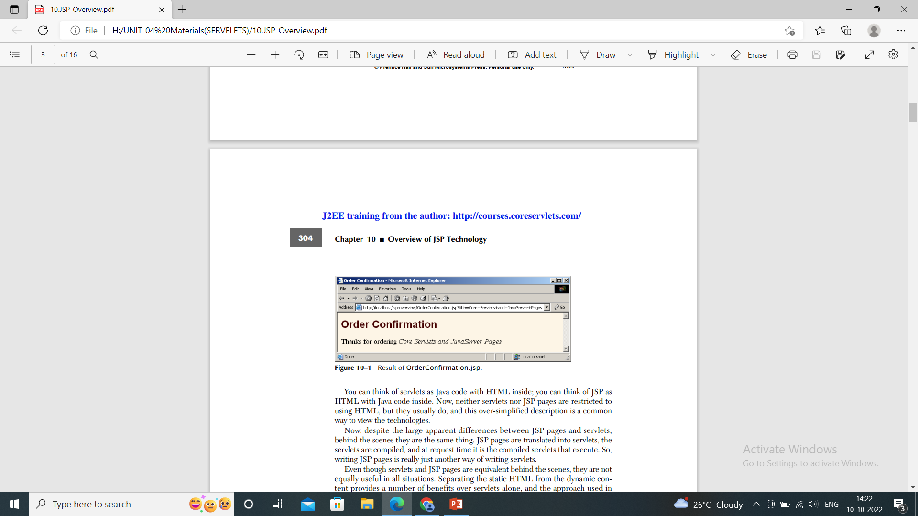

Slide 4
Benefits of JSP
JSP provides the following benefits over servlets alone:
It is easier to write and maintain the HTML: Your static code is ordinary HTML: no extra backslashes, no double quotes, and no lurking Java syntax.
You can use standard Web-site development tools: Even HTML tools that know nothing about JSP can be used because they simply ignore the JSP tags.
You can divide up your development team: The Java programmers can work on the dynamic code. The Web developers can concentrate on the presentation layer. On large projects, this division is very important. Depending on the size of your team and the complexity of your project, you can enforce a weaker or stronger separation between the static HTML and the dynamic content.

Slide 5
Advantages of JSP Over Competing Technologies
Versus PHP
JSP is a server-side programming technology, whereas PHP is a server-side scripting language.
Products written in JSPs can be debugged by editors, whereas PHP has a print statement to debug code.
JSP is an abstraction of the Java class, so it can be garbage collected, whereas PHP does not support garbage collection.
JSP execution requires a servlet container like Tomcat since it is a servlet in disguise, whereas PHP can run on its own as a CGI engine.

Slide 6
Versus Pure Servlets
Extension to Servlet
We can use all the features of the Servlet in JSP. In addition to, we can use implicit objects, predefined tags, expression language and Custom tags in JSP, that makes JSP development easy.
Easy to maintain
JSP can be easily managed because we can easily separate our business logic with presentation logic. In Servlet technology, we mix our business logic with the presentation logic.
Less code than Servlet
In JSP, we can use many tags such as action tags, JSTL, custom tags, etc. that reduces the code. Moreover, we can use implicit objects, etc.

Slide 7
Versus JavaScript
JavaScript can generate HTML dynamically on the client but can hardly interact with the web server to perform complex tasks like database access and image processing etc.
Java Server Pages has JSTL support to handle a few complex features, whereas JavaScript has different data types such as Boolean, Number, String, Date, Math, HTML DOM, and RegExp etc.,
Java Server Pages support Expression Language (EL) that provides access to functions and the data in Java objects, whereas JavaScript has implicit prototype reference to refer to the data in JS objects.

Slide 8
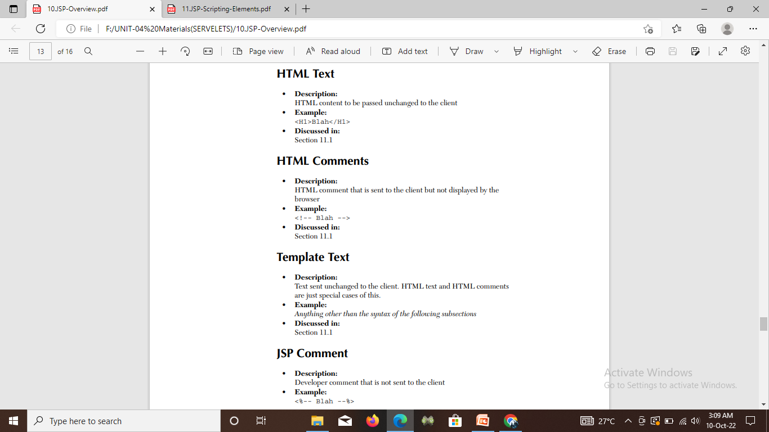
Basic Syntax

Slide 9
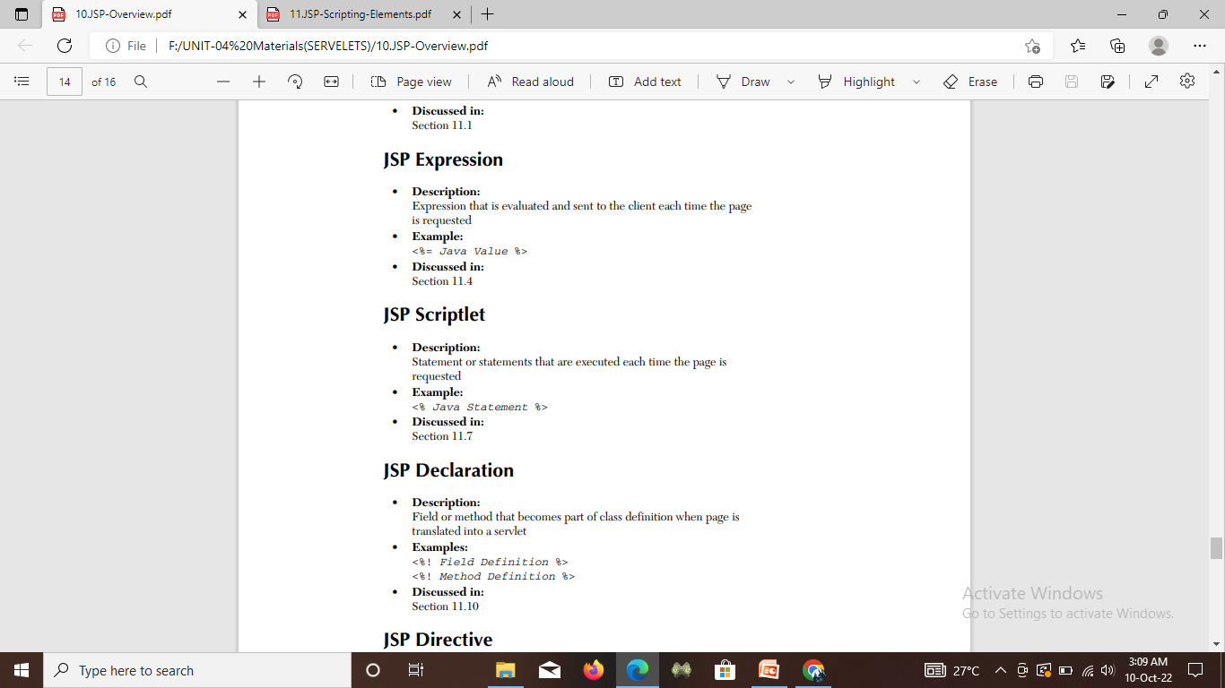

Slide 10
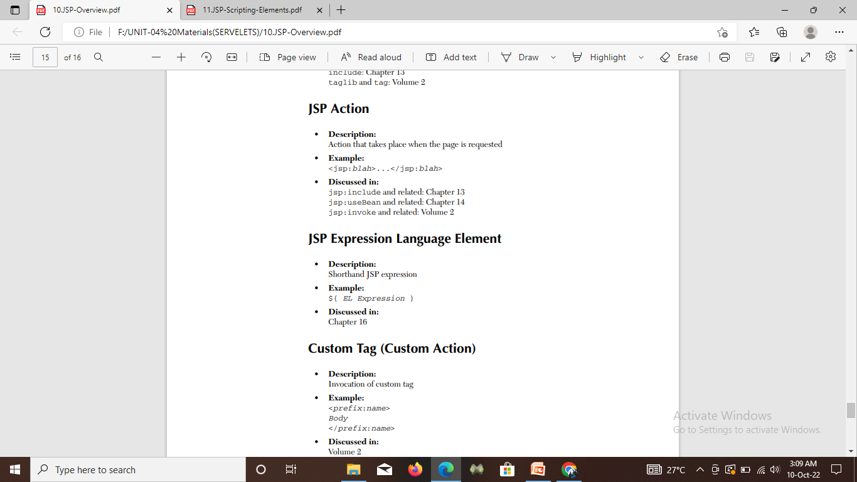

Slide 11
Creating Template Text
A large percentage of your JSP document consists of static text (usually HTML), known as template text.
In almost all respects, this HTML looks just like normal HTML, follows all the same syntax rules.
There are two minor exceptions:
First, if you want to have<% or %> in the output, you need to put in the<\% or \%> template text.
Second, if you want a comment to appear in the JSP page but not in the resultant document, use
<%------ JSP COMMENT------%>

Slide 12
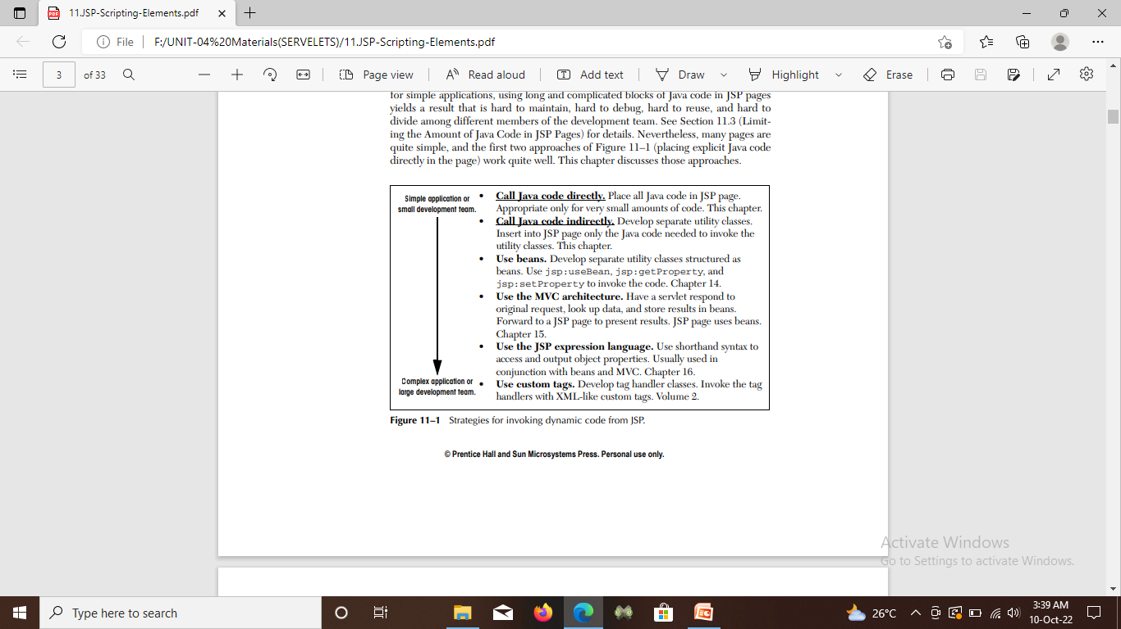
Invoking Java Code from JSP
Call Java code directly: Place all Java code in JSP page. Appropriate only for very small amounts of code.
Call Java code indirectly: Develop separate utility classes. Insert into JSP page only the Java code needed to invoke the utility classes.
Use beans: Develop separate utility classes structured as beans. Use jsp:useBean, jsp:getProperty, and jsp:setProperty to invoke the code.
Use the MVC architecture. Have a servlet respond to original request, look up data, and store results in beans. Forward to a JSP page to present results. JSP page uses beans.
Use the JSP expression language: Use shorthand syntax to access and output object properties. Usually used in conjunction with beans and MVC.
Use custom tags: Develop tag handler classes. Invoke the tag handlers with XML-like custom tags.

Slide 13
Limiting the Amount of Java Code in JSP Pages
You have 25 lines of Java code that you need to invoke.
You have two options:
(1) put all 25 lines directly in the JSP page.
(2) put the 25 lines of code in a separate Java class, put the Java class in WEB-INF/classes/directoryMatchingPackageName, and use one or two lines of JSP-based Java code to invoke it.
Advantages of going with option 2:
Development: You generally write regular classes in a Java-oriented. You generally write JSP in an HTML oriented environment like Dreamweaver. The Java-oriented environment is typically better at balancing parentheses, providing tooltips, checking the syntax, colorizing the code, and so forth.

Slide 14
Compilation: To compile a regular Java class, you press the Build button in your IDE or invoke javac. To compile a JSP page, you have to drop it in the right directory, start the server, open a browser, and enter the appropriate URL.
Division of labor: Many large development teams are composed of some people who are experts in the Java language and others who are experts in HTML but know little or no Java. The more Java code that is directly in the page, the harder it is for the Web developers (the HTML experts) to manipulate it.

Slide 15
Using JSP Expressions
A JSP expression is used to insert values directly into the output. It has the following form:
<%= Java Expression %>
The expression is evaluated, converted to a string, and inserted in the page. This evaluation is performed at runtime (when the page is requested) and thus has full access to information about the request.
Predefined Variables:
To simplify these expressions, you can use a number of predefined variables.
• request, the HttpServletRequest.
• response, the HttpServletResponse.
• session, the HttpSession associated with the request .
• out, the Writer used to send output to the client.
• application, the ServletContext.
This is a data structure shared by all servlets and JSP pages in the Web application and is good for storing shared data.

Slide 16
Comparing Servlets to JSP Pages
The JSP version is clearly superior, shorter, simpler, and easier to maintain.
Now, this is not to say that all servlets will convert to JSP so cleanly.
JSP works best when the structure of the HTML page is fixed but the values at various places need to be computed dynamically.
If the structure of the page is dynamic, JSP is less beneficial. Sometimes servlets are better in such a case. And, of course, if the page consists of binary data or has little static content, servlets are clearly superior.
Furthermore, sometimes the answer is neither servlets nor JSP alone, but rather a combination of the two.

Slide 17
Writing Scriptlets
If you want to do something more complex than output the value of a simple expression, JSP scriptlets let you insert arbitrary code into the servlet’s jsp Service method . Scriptlets have the following form:
<% java code%>
if you want to explicitly send output to the resultant page, you could use the out variable, as in the following example
<%
String queryData = request.getQueryString();
out.println("Attached GET data: " + queryData);
%>
you could have accomplished the same effect more easily by using a combination of a scriptlet and a JSP expression,
<%String queryData = request.getQueryString();%>
Attached GET data: =<% request.getQueryString()%>

Slide 18
Using Declarations
A JSP declaration lets you define methods or fields that get inserted into the main body of the servlet class
<%= Field or Method Definition%>
Declarations do not generate output, they are normally used in conjunction with JSP expressions or scriptlets.
In principle, JSP declarations can contain field (instance variable) definitions, method definitions, inner class definitions, or even static initializer blocks.
One caution is : do not use JSP declarations to override the standard servlet life-cycle methods.

Slide 19
CONTROLLING THE STRUCTURE OF GENERATED SERVLETS: THE JSP PAGE DIRECTIVE
A JSP directive affects the overall structure of the servlet that results from the JSP page.
In JSP, there are three main types of directives:
1. page,
2. Include
3. taglib.
The page directive lets you control the structure of the servlet by importing classes, customizing the servlet super class, setting the content type.
The second directive, include, lets you insert a file into the JSP page at the time the JSP file is translated into a servlet. An include directive should be placed in the document at the point at which you want the file to be inserted.
The third directive, taglib, defines custom markup tags.

Slide 20
The import Attribute
The import attribute of the page directive lets you specify the packages that should be imported by the servlet into which the JSP page gets translated.
using separate utility (helper) classes makes your dynamic code easier to write, maintain, debug, test, and reuse.
When you use utility classes, remember that they should always be in packages. For one thing, packages are a good strategy on any large project because they help protect against name conflicts. With JSP, however, packages are absolutely required. The reason is that, in the absence of packages, classes you reference are assumed to be in the same package as the current class.

Slide 21
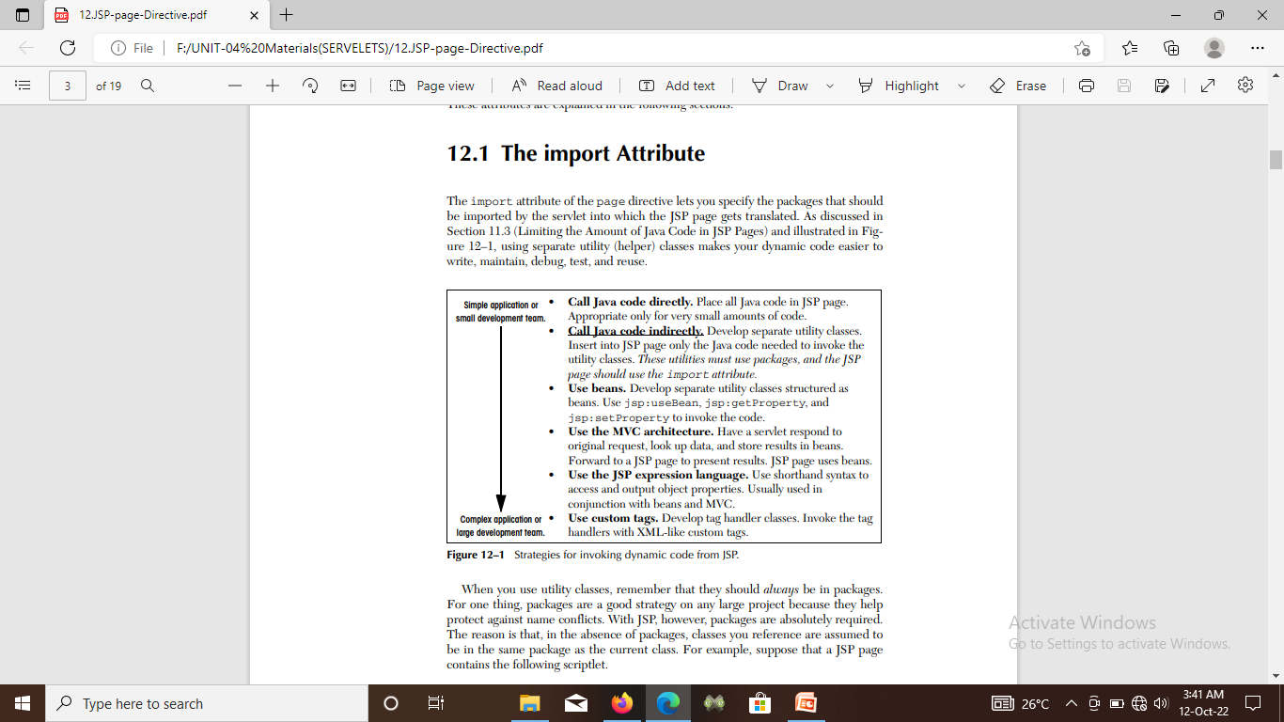
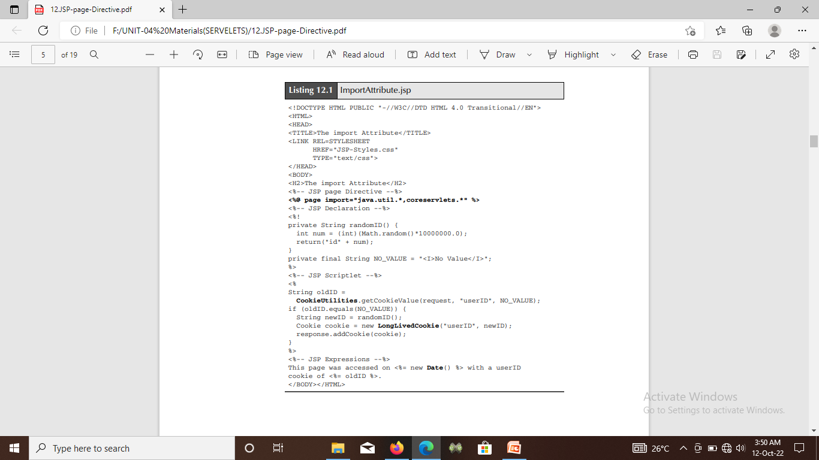
The import attribute is the only page attribute that is allowed to appear multiple times within the same document.
Although page directives can appear anywhere within the document, it is traditional to place import statements either near the top of the document or just before the first place that the referenced package is used.

Slide 22
The session Attribute
The session attribute controls whether the page participates in HTTP sessions. Use of this attribute takes one of the following two forms:
<%@ page session="true" %> <%--Default--%>
<%@ page session="false" %>
A value of true signifies that the predefined variable session should be bound to the existing session if one exists; otherwise, a new session should be created and bound to session.
A value of false means that no sessions will be automatically created and that attempts to access the variable session will result in errors at the time the JSP page is translated into a servlet.
Using session="false" may save significant amounts of server memory on high-traffic sites. However, note that using session="false" does not disable session tracking—it merely prevents the JSP page from creating new sessions for users who don’t have them already.

Slide 23
The isELIgnored Attribute
The isELIgnored attribute controls whether the JSP 2.0 Expression Language (EL) is ignored (true) or evaluated normally (false).
This attribute is new in JSP 2.0; it is illegal to use it in a server that supports only JSP 1.2 or earlier.
The default value of the attribute depends on the version of web.xml you use for your Web application.
Use of this attribute takes one of the following two forms.
<%@ page isELIgnored="false" %>
<%@ page isELIgnored=“true" %>

Slide 24
The buffer and auto Flush Attributes
The buffer attribute specifies the size of the buffer used by the out variable, which is of type Jsp Writer.
Use of this attribute takes one of two forms:
<%@ page buffer="sizekb" %>
<%@ page buffer="none" %>
Servers can use a larger buffer than you specify, but not a smaller one. For example, means the document content should be buffered and not sent to the client until at least 32 kilobytes are accumulated, the page is completed, or the output is explicitly flushed.
The default buffer size is server specific, but must be atleast 8 kilobytes.

Slide 25
autoFlush attribute
The autoFlush attribute controls whether the output buffer should be automatically flushed when it is full (the default) or whether an exception should be raised when the buffer overflows (autoFlush="false").
Use of this attribute takes one of the following two forms.
<%@ page autoFlush="true" %> <%-- Default --%>
<%@ page autoFlush="false" %>
A value of false is illegal when buffer="none" is also used.
Use of autoFlush="false" is exceedingly rare when the client is a normal Web browser. However, if the client is a custom application, you might want to guarantee that the application either receives a complete message or no message at all.

Slide 26
info attribute
The info attribute defines a string that can be retrieved from the servlet by means of the getServletInfo method.
Use of info takes the following form:
<%@ page info="Some Message" %>

Slide 27
The errorPage and isErrorPage Attributes
The error Page attribute specifies a JSP page that should process any exceptions thrown but not caught in the current page.
It is used as follows:
<%@ page errorPage="Relative URL" %>
The exception thrown will automatically be available to the designated error page by means of the exception variable.

Slide 28
isErrorPage attribute
The isErrorPage attribute indicates whether or not the current page can act as the error page for another JSP page.
Use of isErrorPage takes one of the following two forms:
<%@ page isErrorPage="true" %>
<%@ page isErrorPage="false" %> <%-- Default --%>

Slide 29
The isThreadSafe Attribute
The isThreadSafe attribute controls whether the servlet that results from the JSP page will allow concurrent access or will guarantee that no servlet instance processes more than one request at a time (isThreadSafe="false").
Use of the isThreadSafe attribute takes one of the following two forms:
<%@ page isThreadSafe="true" %> <%-- Default --%>
<%@ page isThreadSafe="false" %>

Slide 30
The extends Attribute
The extends attribute designates the superclass of the servlet that will be generated for the JSP page.
It takes the following form:
<%@ page extends="package.class" %>
This attribute is normally reserved for developers or vendors that implement fundamental changes to the way in which pages operate.

Slide 31
The language Attribute
The language attribute is intended to specify the scripting language being used, as below:
<%@ page language="cobol" %>

